Slide 1

Loan Eligibility Prediction using Machine Learning Models
Welcome to our presentation on Loan Eligibility Prediction using machine learning models. In this presentation, we will explore the purpose, importance, data preprocessing techniques, machine learning models, and model evaluation.
by Jennie Priyanka (RA2112702010001)

Slide 2

Table of Contents
Introduction
Literature Survey
Problem Statement
Objective
System Architecture
Machine Learning Model
Model Evaluation
Conclusion

Slide 3

Introduction
Loan eligibility prediction is crucial in the financial industry. Accurate prediction helps streamline the loan approval process, reduces the risk of defaults, and improves customer satisfaction. This presentation provides a comprehensive overview of the topic.

Slide 4
Literature Survey
Paper 1: "Credit Scoring using Logistic Regression"
Methodology: This paper employs a traditional logistic regression model for loan eligibility prediction. Features used are basic demographic and financial information.
Improvements: Subsequent research improved upon this by incorporating additional features, such as social media data and transaction history, resulting in more accurate predictions.
Paper 2: "Random Forest for Credit Risk Assessment"
Methodology: This study applies a Random Forest model for loan eligibility prediction, considering various financial indicators and credit history.
Improvements: Recent work has enhanced this approach by exploring advanced ensemble techniques like gradient boosting and XGBoost, which exhibit better performance compared to traditional Random Forest.
Paper 3: "Deep Learning for Credit Scoring"
Methodology: This paper introduces a neural network model with multiple hidden layers, allowing for the automatic extraction of complex patterns from the data.
Improvements: Current research in deep learning has extended this by utilizing convolutional neural networks (CNNs) for image-based data, recurrent neural networks (RNNs) for time series data, and transformer-based models like BERT for textual information, resulting in more accurate and versatile predictions.

Slide 5
Literature Survey
Paper 4: "Addressing Imbalanced Data in Loan Eligibility Prediction"
Methodology: This research focuses on handling imbalanced datasets by applying techniques such as oversampling the minority class and using different evaluation metrics.
Improvements: Recent studies have improved this area by proposing advanced methods like synthetic data generation through Generative Adversarial Networks (GANs) and utilizing cost-sensitive learning techniques, which provide more robust models in the presence of class imbalance.
Paper 5: "Explainable AI for Credit Scoring"
Methodology: This paper emphasizes the importance of model interpretability in the financial sector by using techniques like LIME and SHAP for feature attribution.
Improvements: Recent work in this domain has furthered the field by developing custom interpretable models and combining them with more complex models to balance transparency and prediction accuracy effectively.
Paper 6: "Ensemble Learning for Loan Eligibility Prediction"
Methodology: This research explores the combination of multiple models (e.g., Random Forest, SVM, and logistic regression) to improve prediction performance.
Improvements: Current research has refined this by applying model stacking techniques, where the predictions of base models are used as inputs for a meta-learner, leading to significant performance boosts.

Slide 6

Objective
To Improve Loan Approval Process Efficiency
To Minimize Credit Risk and Default Rates:
To Enhance Fairness and Equity in Lending:

Slide 7
Data Preprocessing
Data preprocessing plays a vital role in loan eligibility prediction. It involves cleaning and imputing missing data, feature engineering and selection, and scaling and normalization. These steps ensure the data is ready for analysis and model training.

Slide 8

Machine Learning Models
Decision Tree :
A Decision Tree Classifier is a supervised machine learning algorithm that is commonly used for classification tasks. In the context of loan eligibility prediction, a decision tree is a tree-like structure where each node represents a feature or attribute, and each branch represents a decision or a rule. The leaves of the tree represent class labels (e.g., "Approved" or "Rejected" for loans).
Navie Bayes :
To use the Naive Bayes classifier for loan eligibility prediction, you first calculate the conditional probability of an application being approved or rejected given the values of its features. This is done for each class. The final decision is made by selecting the class with the highest conditional probability.

Slide 9

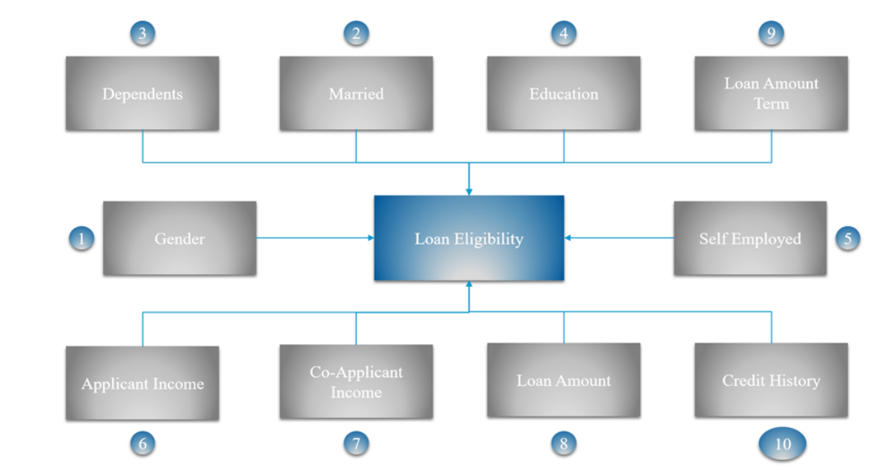
Proposed System Architecture

Slide 10
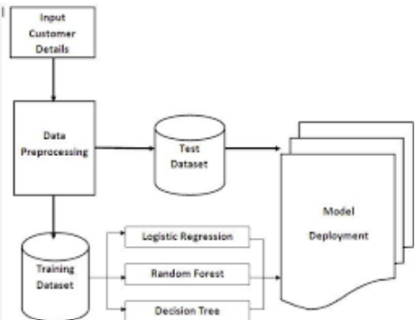
Proposed System Architecture

Slide 11
Model Evaluation
Evaluating the performance of machine learning models is crucial to determine their effectiveness in loan eligibility prediction. We use various evaluation metrics such as accuracy, precision, recall, and cross-validation techniques to assess the models' performance. Model comparison helps identify the best-performing model.

Slide 12

Conclusion
In conclusion, loan eligibility prediction using machine learning models is a valuable tool for financial institutions. Through our analysis, we have summarized the findings, explored potential applications, and discussed future directions for research in this field.

